Slide 1



Online Learning Platform: Transforming Education
Welcome to our presentation on the future of education: an online learning platform that empowers students and educators alike.
By Bhanu pratap singh and Ashish nagar.
Notes:
1

Slide 2
The Rise of Remote Learning
Flexibility
Accessibility
Engagement
Learn anytime, anywhere, at your own pace.
Break down geographical and financial barriers to education.
Interactive content and personalized learning experiences keep students motivated.
Notes:
2

Slide 3
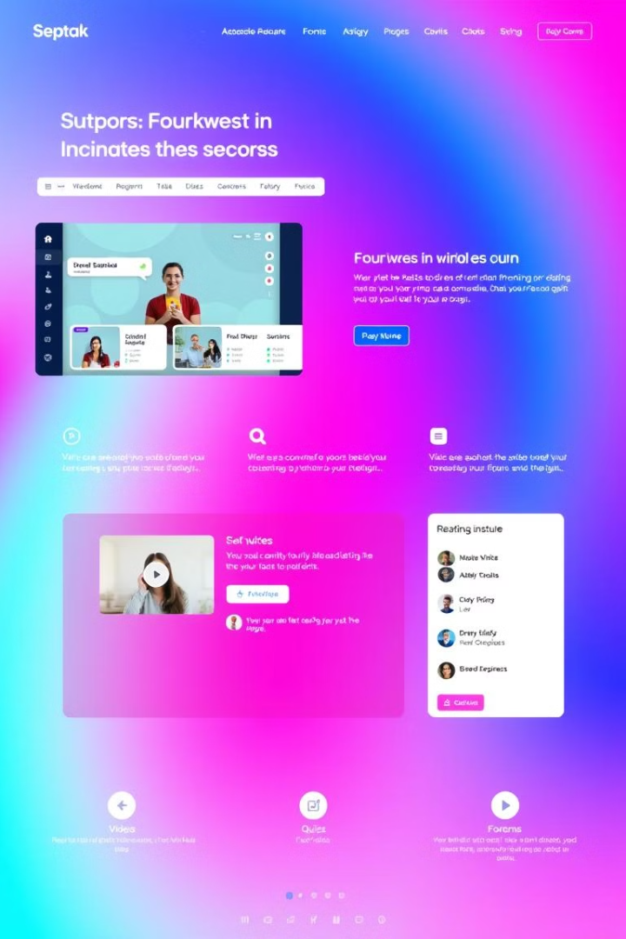
Key Features of Our Platform
1
Course Library
2
Subject wise feedback
A comprehensive library of high-quality courses across various disciplines.
Track student progress, provide feedback, and measure learning outcomes.
3
Community Forums
Connect with peers, instructors, and experts for collaboration and support.
Notes:
3

Slide 4



Personalized Learning Pathways
Needs Assessment
1
Identify your learning goals and areas for improvement.
2
Personalized Recommendations
Receive customized learning paths tailored to your interests and skills.
Adaptive Learning
3
The platform adjusts difficulty based on your progress and understanding.
Notes:
4

Slide 5
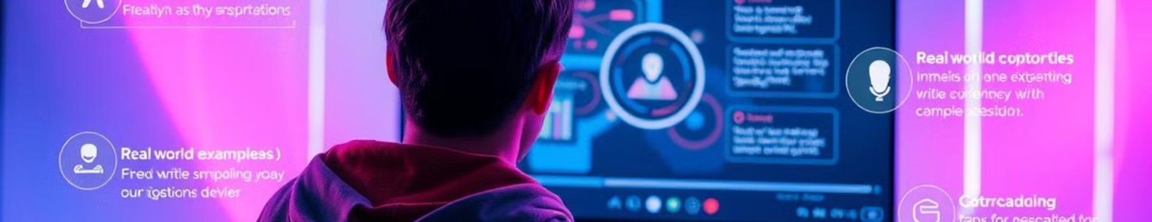

Engaging Interactive Lessons
Video Lectures
Interactive Quizzes
Gamified Learning
Experience engaging video lessons from top instructors.
Test your knowledge and receive immediate feedback.
Make learning fun and rewarding with interactive games and challenges.
Notes:
5

Slide 6




Seamless Collaboration Tools
Group Projects
Collaborate with peers on real-world projects and assignments.
Discussion Forums
Engage in discussions, share ideas, and ask questions.
Virtual Meeting Rooms
Connect with instructors and classmates in real-time for live sessions.
Notes:
6

Slide 7
Mobile-Friendly Experience
1
Responsive Design
The platform adapts to different screen sizes for a seamless experience.
2
Offline Access
Download content for offline learning and study anytime.
Notifications and Updates
3
Stay informed about deadlines, assignments, and course updates.
Notes:
7

